Slide 1
GROUP PRESENTATION
Bright Onapito, Nicholas Ssesinde, Osbert Osamai and Denis Kisina
THREAT MODELLING & ATTACK TREES

Slide 2
Threat Modeling and Attack Trees
Introduction
What is threat modeling
Purpose
Creating a threat model
Threat / Attack Trees
Creating an attack Tree

Slide 3
Introduction
The process of securing applications begins with understanding the threats against your applications.
The overriding driver of threat modeling is that you cannot build secure systems until you evaluate the threats to the application with the goal of reducing the overall risk. The good news is that threat modeling is simple, but it does require significant time investment to get right.

Slide 4
Threat Modeling: Definition
Threat modeling is an engineering technique you can use to help you identify threats, attacks, vulnerabilities, and countermeasures in the context of your application scenario.
Can help to assess the probability, potential harm, priority among others of attacks and thus help to minimize or mitigate them.
The threat modeling activity helps you to:
  Identify your security objectives.
  Identify relevant threats.
  Identify relevant vulnerabilities and countermeasures.

Slide 5
Terminologies In Threat Modeling
Threat modeling uses the following terms:
Asset. An asset is a resource of value. It varies by perspective. To a business, an asset might be the availability of information, or the information itself, such as customer data. It might be intangible, such as a company's reputation. To an attacker, an asset could be the ability to misuse your application for unauthorized access to data or privileged operations.
Threat. A threat is an undesired event. A potential occurrence, often best described as an effect that might damage or compromise an asset or objective. It may or may not be malicious in nature.

Slide 6
Terminology Cont’d
Vulnerability. A vulnerability is a weakness in some aspect or feature of a system that makes an exploit possible. Vulnerabilities can exist at the network, host, or application levels and include operational practices.
Attack (or exploit). An attack is an action taken that utilizes one or more vulnerabilities to realize a threat. This could be someone following through on a threat or exploiting a vulnerability.
Countermeasure. Countermeasures address vulnerabilities to reduce the probability of attacks or the impacts of threats. They do not directly address threats; instead, they address the factors that define the threats. Countermeasures range from improving application design, or improving your code, to improving an operational practice.

Slide 7
Threat Modeling : Purpose
Use threat modeling to:
Shape your application design to meet your security objectives. Defines the security of an application
Identifies and investigates potential threats and vulnerabilities
Reduce risk of security issues arising during development and operations.

Slide 8
Threat Modeling: Purpose
Threat models help you understand your application better. If you spend time analyzing the makeup of your application in a relatively structured manner.
Creates a set of documents that are used to create security specifications and security testing, thus preventing duplication of security efforts
Results in fewer vulnerabilities
Brings justification for security features at both the hardware and software levels for identified threats

Slide 9
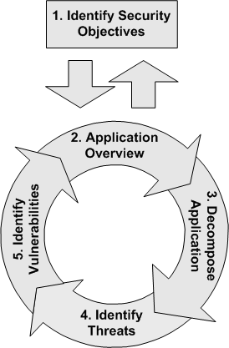
How to create a threat model

Slide 10
How to create a threat model
The five threat modeling steps are:
Step 1: Identify security objectives. Clear objectives help you to focus the threat modeling activity and determine how much effort to spend on subsequent steps.
Step 2: Create an application overview. Itemizing your application's important characteristics and actors helps you to identify relevant threats during step 4.
Step 3: Decompose your application. A detailed understanding of the mechanics of your application makes it easier for you to uncover more relevant and more detailed threats.

Slide 11
How to create a threat model
Step 4: Identify threats. Use details from steps 2 and 3 to identify threats relevant to your application scenario and context . Question driven approach can help you Identify relevant threats and attacks. E.g. The STRIDE Model .
You can use the STRIDE model to ask questions related to each aspect of the architecture and design of your application.
This is a goal-based approach, where you consider the goals of an attacker. For example:-
Could an attacker spoof an identity to access your server or Web application?
Could someone tamper with data over the network or in a data store?
Is sensitive information disclosed when you report an error message or log an event?
Could someone deny service?

Slide 12
How to create a threat model
Step 5: Identify vulnerabilities. Review the layers of your application to identify weaknesses related to your threats. Use vulnerability categories to help you focus on those areas where mistakes are most often made.
You should progressively refine your threat model by repeatedly performing steps 2 through 5. You will be able to add more detail as you move through your application development life cycle and discover more about your application design.

Slide 13
What comes after Threat modeling
The output of the threat modeling process includes documentation of the security aspects of the architecture of your application and a list of rated threats. The threat model helps you orchestrate development team members and focus on the most potent threats.
Threat modeling should not be a one time only process. It should be an iterative process that starts during the early phases of the design of your application and continues throughout the application life cycle.

Slide 14
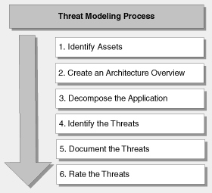
Summary

Slide 15
Threat/ Attack Tree
Threats must be analyzed to discover where the system is susceptible to the threat by building a threat tree
The idea behind threat trees is that an application is composed of threat targets and that each target could have vulnerabilities that when successfully attacked could compromise the system.
Threat trees describe the decision-making process an attacker goes through to compromise the component

Slide 16

Creating Attack Trees
When creating an attack tree, assume the role of the attacker. Consider what you must do to launch a successful attack and identify goals and sub-goals of the attack.
You can use a hierarchical diagram to represent your attack tree, or you can use a simple outline.
An adversary only sees exposed services…

Slide 17
Creating Attack Trees
To create an attack tree, you must first define the root node.
Start building an attack tree by creating root nodes that represent the goals of the attacker. Then add the leaf nodes, which are the attack methodologies that represent unique attacks.
For example, one attack objective might be "Steal ABC Corp.'s Customers' Account Data."
How to achieve This:-
Obtain backup tapes from ABC's file server.
Intercept email between ABC Corp. and their customers.
Compromise ABC Corp.'s file server from over the Internet.

Slide 18

Attack Tree
These three sub goals are the leaf nodes immediately below our root node
Next, for each leaf node, you determine sub goals that achieve that leaf node's goal. These become the next "layer" of leaf nodes. This step is repeated as necessary to achieve the level of detail and complexity with which you wish to examine the attack.

Slide 19
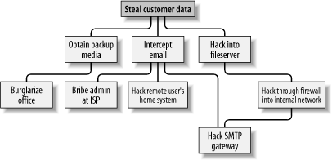
More detailed attack tree

Slide 20
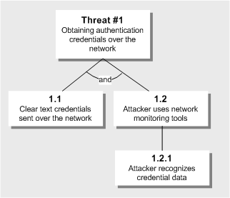
Attack Tree- Example 2
You can label leaf nodes with AND and OR labels. For example, in above, both 1.1 and 1.2 must occur for the threat to result in an attack.

Slide 21
Attack Tree- Example
Although trees communicate data well they tend to be cumbersome when building large threat models.
Attack trees have a tendency to become complex quickly. They are also time-consuming to create.
An alternative approach is to structure your attack tree using an outline, such as the following.
1. Goal One
1.1 Sub-goal one
1.2 Sub-goal two2
2. Goal Two
2.1 Sub-goal one
2.2 Sub-goal two

Slide 22
Attack tree- Outline
The following outline represents the threat tree in an outline format:-
1.0 View confidential payroll data on the wire
1.1 HTTP traffic is unprotected (AND)
1.2 Attacker views traffic
1.2.1 Sniff network traffic with
protocol analyzer
1.2.2 Listen to router traffic
1.2.2.1 Router is unpatched (AND)
1.2.2.2 Compromise router
1.2.2.3 Guess router password
1.2.3 Compromise switch
1.2.3.1 Various switch attacks

Slide 23
References
Threat Modeling Web Applications
http://msdn.microsoft.com/en-us/library/ff648006.aspx
Threat Modeling
http://www.devx.com/codemag/Article/10338/1763
Section 1.3. An Alternative: Attack Trees
http://etutorials.org/Linux+systems/secure+linux based+servers/Chapter+1.+Threat+Modeling+and+Risk+Management/Section+1.3.+An+Alternative+Attack+Trees/#
Creating a Threat Model
http://web.securityinnovation.com/appsec-weekly/blog/bid/56432/Create-a-Threat-Model-Step-3

